Slide 1
Website
Silver Oak Collage Of Computer Application
Semester : 2nd
Div:M1A4
Div : Internship(HTML/CSS)
Project Name : Own Create Website
Project Guide : Janvi Malani(sister)

Slide 2
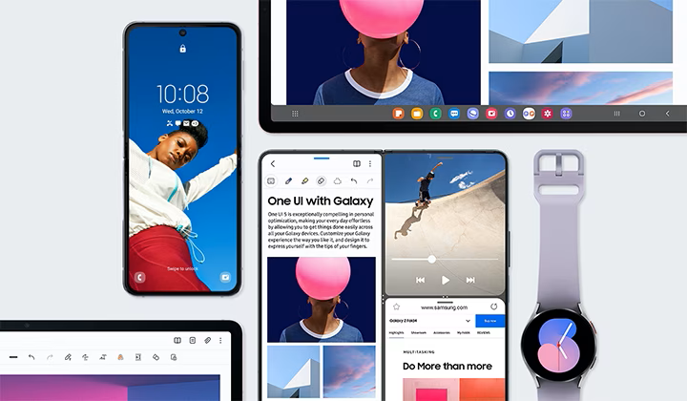
Agenda
HOME
About
Contact
Faqs

Slide 3

Introduction
Watch Products Up To50% off
The more significant challenge is differentiating a watch from a pool of excellent products. So brands have turned to different strategies all aimed at communicating perspectives and attitudes towards the brand in general with every model building towards the.

Slide 4
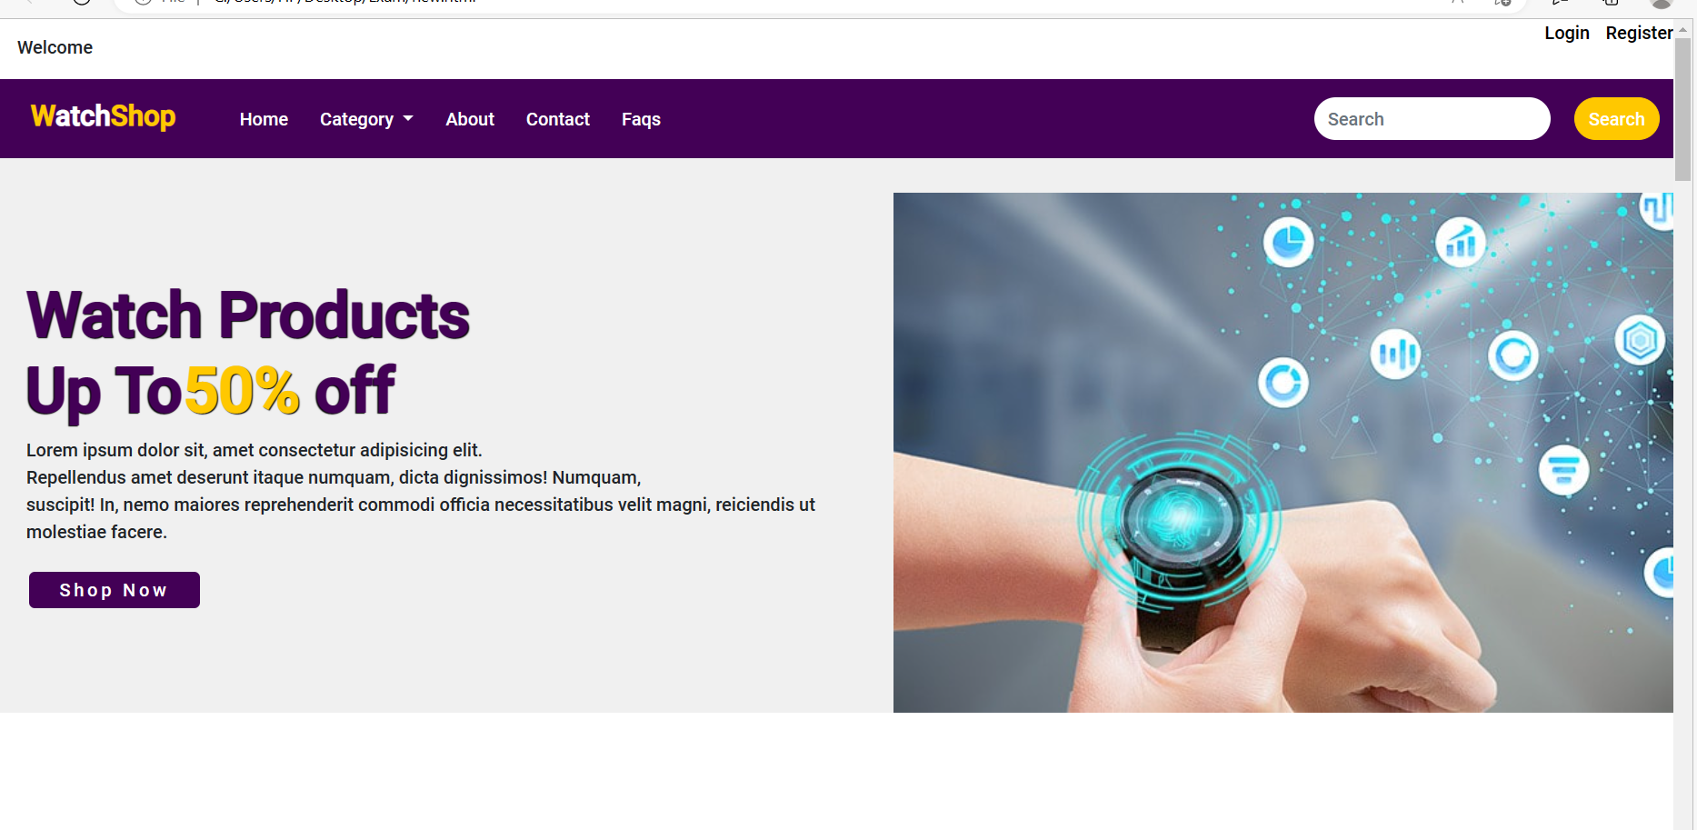
Menu

Slide 5
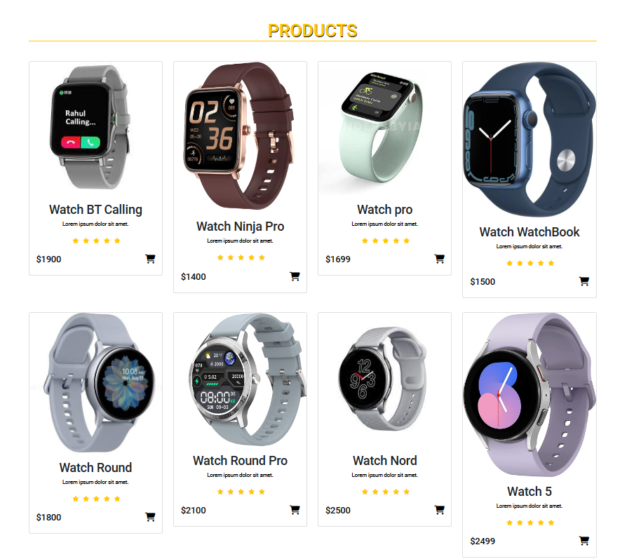
Home
HOME

Slide 6
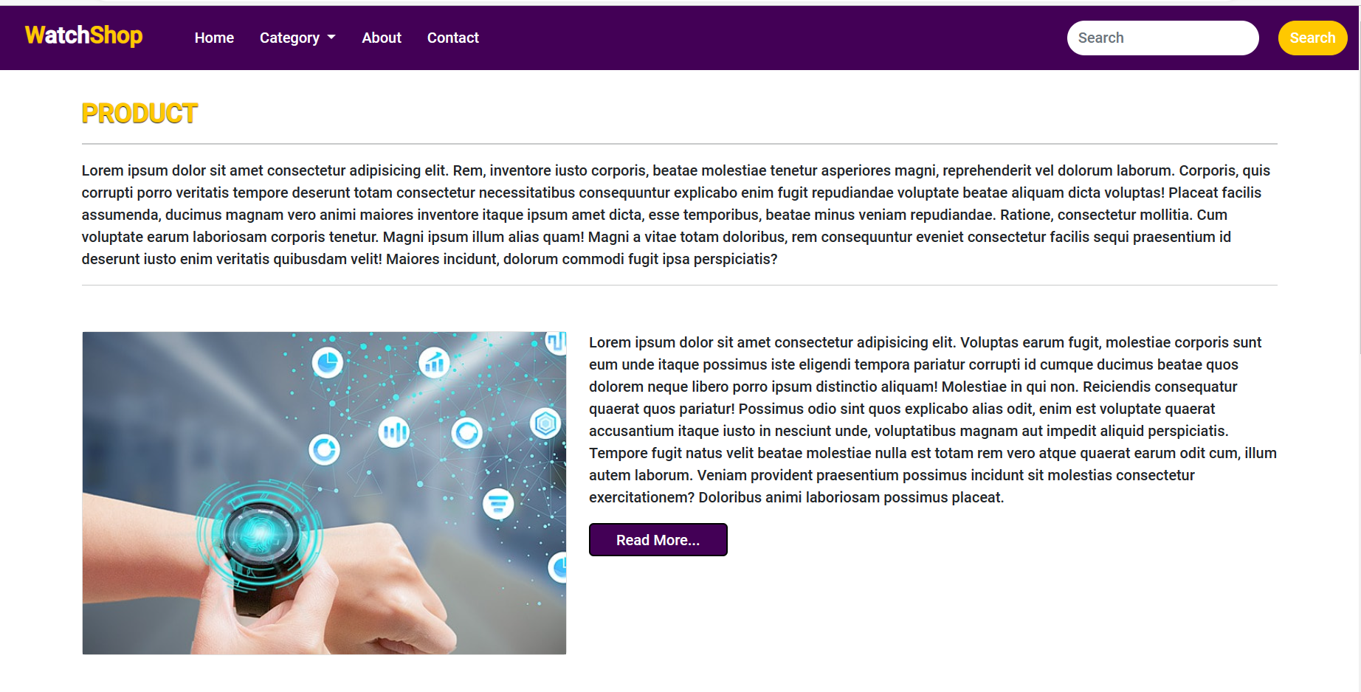
About

Slide 7
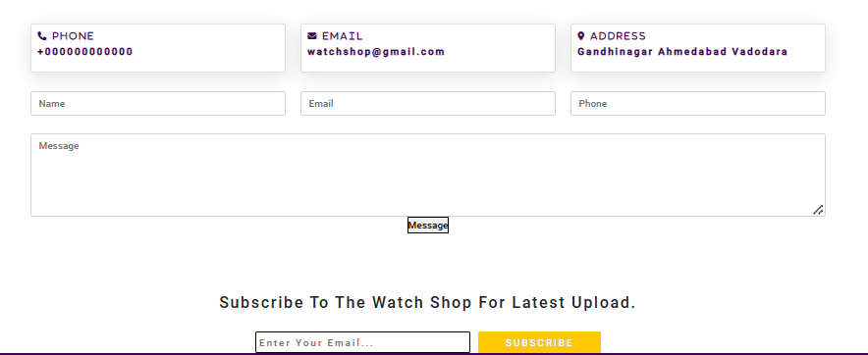

Slide 8
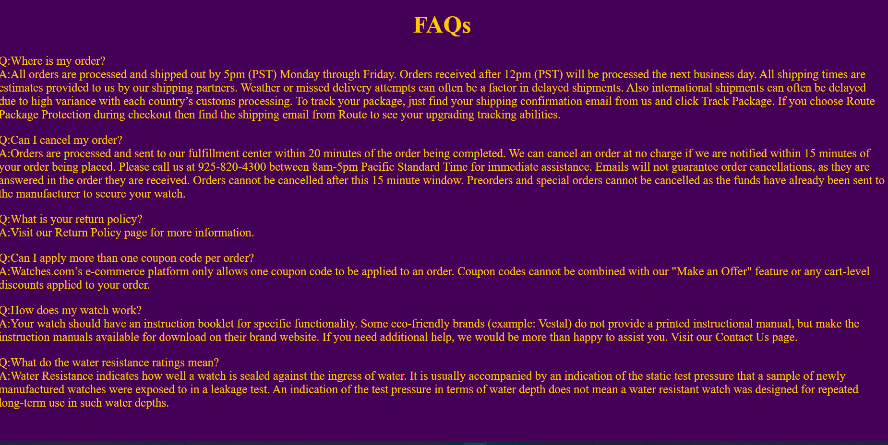
FAQS

Slide 9
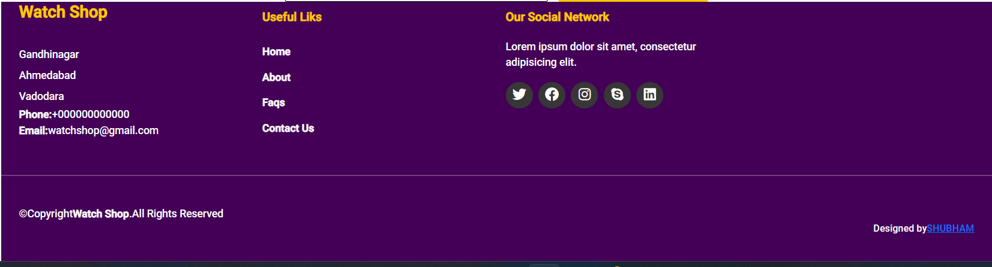
FOOTER

Slide 10
Thank you
Presenter name :Shubham Malani
Email: skmalani05@gmail.com
Github Id: 1710shubham
Website

